Slide 1
Student SURPLUS

Slide 2
CONTENT
Project Description
Requirements
Class Diagram
Sequence Diagram
Core Functionality

Slide 3
Project Description
The goal of the project is to develop a student surplus website which helps students to buy or sell items that they no longer need such as tables, beds, books and furniture just by posting a picture of the item on-site. It’s like a market place where students have the option to select the product, add them to the cart and checkout. The website also provides an additional security feature which helps students securely exchange the products, the students who are willing sell the items should contact the admin to avoid fraudulent postings on the site. Overall, the website provides students the ease of exchanging the unused items efficiently with added security.

Slide 4
requirements
User Registration and Login
Every user of the system will be required to register and maintain an account on the website before he/she can be able to post or buy products on the system.
The system shall request the first name, last name, email address and phone number from the user during registration.
The system shall make sure that a user provides first name, last name and email address during registration. Otherwise, the system shall prevent the user from proceeding.
The system shall check to make sure the data provided by the user on the registration form are of the correct type. If not, the system shall display the errors to the user and request for corrections before proceeding.
The system shall display a registration successful message upon successful registration.
The system shall set-up a profile for the user upon successful registration.
The system shall store the timestamp at which the user created the account.
The system shall request a username and password to authenticate a registered user before he/she can access the buying and posting services on the website.

Slide 5
requirements
Profile maintenance and update
The system shall maintain a profile for each registered user.
The system shall allow the user to update his/her mailing address on his/her profile
The system shall optionally request a user to provide a profile picture
From the profile of the user, the system shall display transaction history of posted items that includes the item name, category, date and time the user posted the item.
The system shall also display the transaction history of items the user has purchased/obtained for free through the website, including the item name, category, seller, date and time the user purchased the item.
The above are our requirements for this, we have not implemented 3.2.3 and 3.2.4 because we have not implemented the product posting module yet and transaction history requires products to be posted by the user.
All the other features and requirements specified in this phase where satisfied, including the criticalities that we mentioned in the deliverable 2.

Slide 6
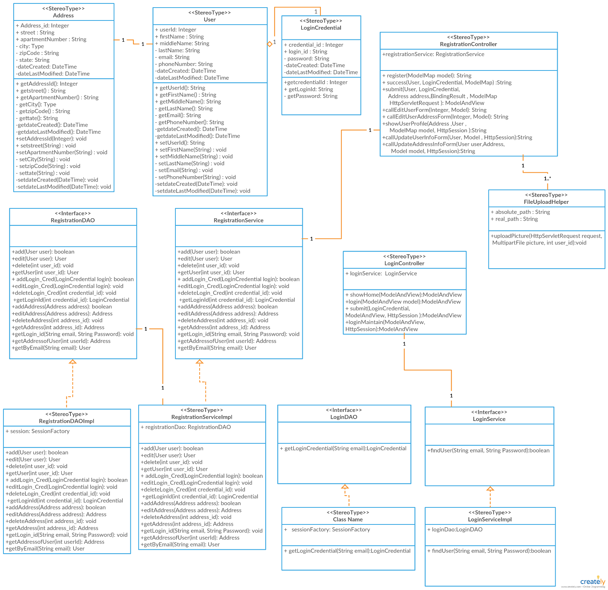
Class diagram
Figure 1: Class Diagram Phase 1 (Diagram created with app on Creately.com)

Slide 7
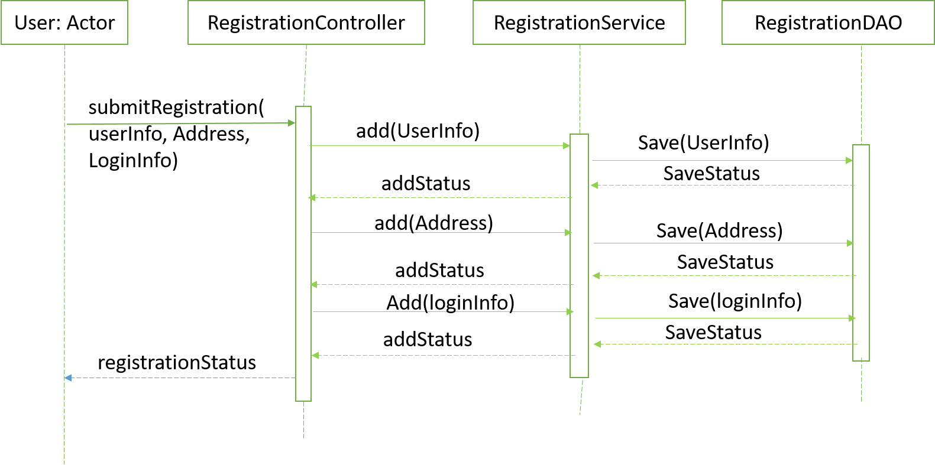
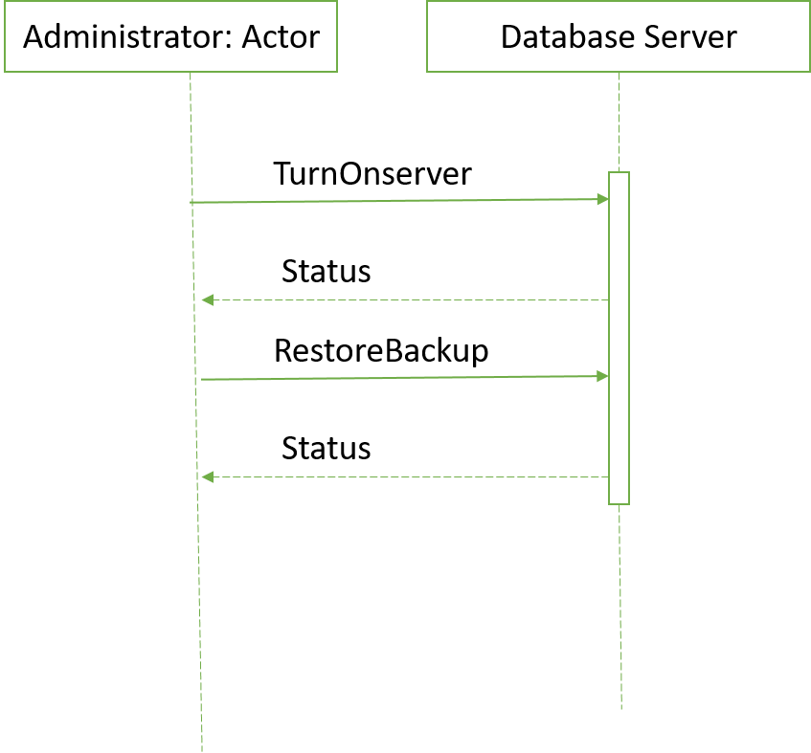
Sequence diagram

Slide 8
Core functionality

Slide 9
Thank you

